Slide 1
Demystifying the NEW NIH Biosketch
Presented by
Office of Research
Rollins School of Public Health
Emory University
February 20, 2015
Janet Gross, PhD
Gary W. Miller, PhD

Slide 2
FASEB Survey on Administrative Burden
NSF and FASEB conducted large scale surveys/studies on the increased administrative burden associated with government-sponsored research. One recommendation was:
“Get rid of the personal statement on the NIH Biosketch”

Slide 3
NIH’s response
Quintuple the effort of the required personal statement by requiring descriptions of contributions to science, while keeping the personal statement for good measure

Slide 4
Comments from Rock Talk
“As someone who has reviewed and been reviewed many many times…part of grantsmanship is to not annoy the reviewer and get dinged. We ding and get dinged for stuff like punctuation and grammar. If the new style biosketch seems exaggerated or even mistakenly perceived to be exaggerated on an application (and Lord help you if you are being evaluated by a competitor) then the “Investigator” score will be negatively impacted. So instead of being helpful, this new initiative could really hurt folks. “

Slide 5
Comments from Rock Talk
“There is only one possible way to agree with this policy: only if this statement of value is written not by the applicant, but by an independent authority in the field who has no publications in common with the applicant. Better yet, by two or three authorities. Better yet, from the future. “

Slide 6
Comments from Rock Talk
“As a science fiction and grant writer, this new NIH biosketch format should generate lots of new business for me. I specialize in the sections that nobody wants to write and fewer folks want to review.”

Slide 7
Comments from Rock Talk
“I would also be in favor of hearing why this is necessary. As a reviewer and grantee, this means more pages and additional work. As a reviewer, I like that applicants have to create their own biosketch, and that it is not completely pre-formatted. One can tell a significant amount about an investigator’s attention to detail in composing a biosketch. “

Slide 8
Advice: vent appropriately, then get over it
It is appropriate and reasonable to dislike the changes. Informing program officers, posting on websites, etc. Are all reasonable actions
However, as of May 2015 the New NIH Biosketch is the new reality.
Not embracing it is a fabulous example of cutting off one’s nose to spite one’s face (a needlessly self-destructive overreaction to a problem)

Slide 9
The New NIH Biosketch

Slide 10
What is the NIH Biosketch?
Highly formatted component of a grant proposal that enables reviewers to evaluate the qualifications of the PI and scientific team that will be executing the research project.

Slide 11
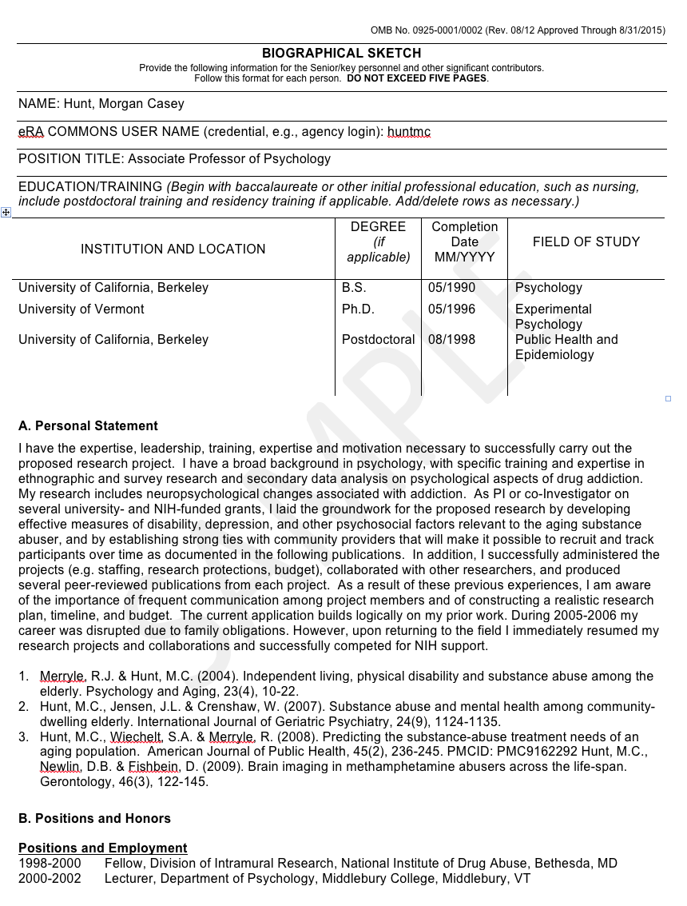
Example posted by NIH for guidance

Slide 12
What do Reviewers look for in the Biosketch?
Are you qualified to do the job?
Is there a good match between your track record (Training + current activities + publications) and the proposed research aims?
Are you a good match for the type of grant you are submitting (e.g., F32 vs. K99/R00 vs. R01)?
Do you have peer-reviewed publications relevant to the proposal or those that suggest that you are likely to publish good science in the future?
Do you have appropriate time/effort devoted to the project? (Research Support [+ Budget Justification])
Too much time on a grant is as important as too little time

Slide 13
NIH Review Criterion that relies on the Biosketch
F- Fellowship Grants | K - Career Development | Standard Grants
Fellowship Applicant | Candidate | Significance
Sponsors, Collaborators and Consultants | Career Dev Plan/Career Goals | Investigator
Research Training Plan | Research Plan | Innovation
Training Potential | Mentors, etc. | Approach
Institutional Environment and Commitment to Training | Environment Commitment to Candidate | Environment
You are not your research but you are your biosketch

Slide 14
What’s New for the Biosketch?
Change occurs on May 25, 2015
5 pages (was 4 pages) maximum
Section C. Contributions to Science
Describe up to 5 of your most significant contributions to science, and for each of these:
indicate the historical background that frames the scientific problem;
the central finding(s);
the influence of the finding(s) on the progress of science or the application of those finding(s) to health or technology; and
your specific role in the described work.

Slide 15
Section C. Contributions to Science (continued)
List up to 4 four peer-reviewed publications or other non-publication research products
Each of the 5 ‘contributions’ can be no more than ½ page each including figures and citations
Provide a URL to a full list of your published work as found in a publicly available digital database such as SciENcv or My Bibliography, which are maintained by the US National Library of Medicine
Complete List of Published Work in My Bibliography: http://www.ncbi.nlm.nih.gov/myncbi/gary.miller.1/bibliography/43347923/public/?sort=date&direction=ascending

Slide 16
New Biosketch Nuts & Bolts

Slide 17
Step #1 to making the transition
There are 3 sets of Instructions and Samples
General
Predoctoral Fellowship
Postdoctoral Fellowship
There are 2 new Blank Format Pages
General biosketch
Fellowship biosketch
(predoctoral and postdoctoral use same page)
All can be found here: http://grants.nih.gov/grants/funding/424/index.htm

Slide 18
Tools: SciENcv - Science Experts Network Curriculum Vitae
Instructional Video:
https://www.youtube.com/watch?v=PRWy-3GXhtU&feature=youtu.be
NIH Notice: NOT-OD-15-032
FAQ’s: http://grants.nih.gov/grants/policy/faq_biosketches.htm

Slide 19
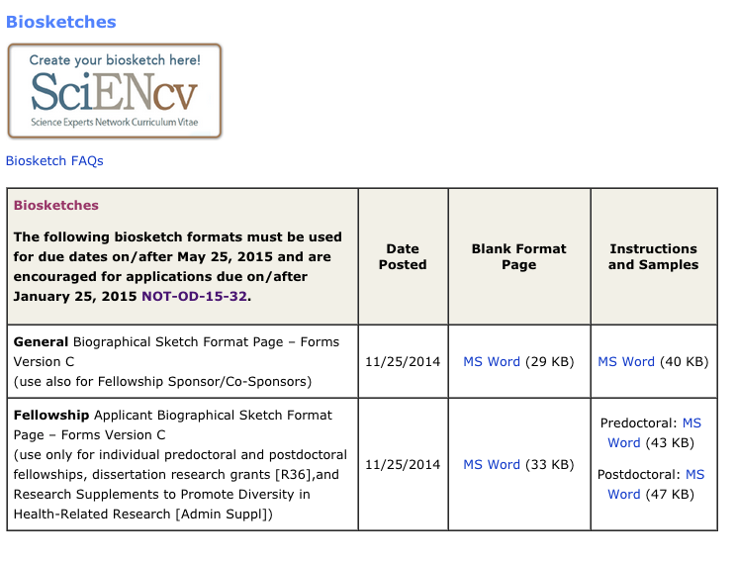
Biosketch Web page http://grants.nih.gov/grants/funding/424/index.htm

Slide 20
NIH grant form pages:
PI
First co-I
Next co-I

Slide 21
Which Biosketch should I use?
Depends who you are (educationally speaking) and what (funding opportunity speaking) you are applying for
Complete the form for the particular grant application you are applying for (rather than what your status is now)
Today I’m a postdoctoral fellow and I’m applying to be Co-I on my mentor’s NIH R01 grant → use Standard Biosketch
Today I’m a Postdoc, and I’m applying for a fellowship grant (F32) → use Fellowship Applicant Biosketch Format Page
Today I’m a Postdoc, and I’m applying for a Career Development Award (K99, K01, K22, etc.) → use Standard Biosketch
Instructions for Foundations and non-NIH funder might be different
Notes:
Gary – This is the corrected slide. Please use this

Slide 22
Sections of the NIH Biosketch
Name, eRA commons, Position, Education & Training
Personal Statement
Positions and Honors
Contributions to Science
Research Support

Slide 23
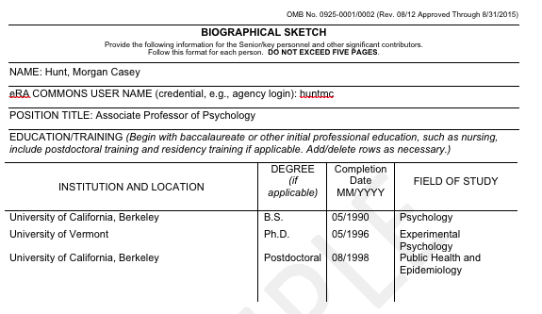
eRA commons user name – obtain this through Office of Sponsored Programs

Slide 24
A. Personal Statement
Briefly describe why you are well-suited to receive the award for which you are applying. The relevant factors may include aspects of your training; your previous experimental work on this specific topic or related topics; your technical expertise; your collaborators or scientific environment; and your past performance in this or related fields (you may mention specific contributions to science that are not included in Section C). Also, you may identify up to four peer-reviewed publications that specifically highlight your experience and qualifications for this project.
If you wish to explain impediments to your past productivity, you may include a description of factors such as family care responsibilities, illness, disability, and active duty military service.

Slide 25
Suggestions for Writing Personal Statements
Customize the personal statement for each grant proposal
Mention the name of the grant proposal (e.g., R15) and speak directly to the purpose of this funding mechanism
E.g.: My goal for this proposed NIH Academic Research Enhancement Award (R15) is to conduct clinical research while further developing and expanding training with graduate students in nursing and psychology to study the etiology of adverse health outcomes associated with stress exposure in women, such as posttraumatic stress disorder (PTSD).

Slide 26
More Suggestions for Writing
Personal Statements
Length – generally no need to exceed Page 1
Convey excitement and passion to do the proposed work
Depending on the type of grant, emphasize your role for:
Leadership (PI of a R grant)
Training potential for you to advance in your field (F32 or K)
Are you a mentor?
Track record and experience to support the proposed aims
Tone should be confident but not arrogant
Don’t just walk us through your accomplishments but speak to the science in this proposal

Slide 27
If you are the PI of the grant….
Even if you are a postdoctoral fellow, you need to read/review / edit the Personal Statement of all other contributors to this proposal
WHY?
Because this is the PI’s job
Each Personal Statement must reflect that writer’s role on the project
If someone is sponsoring / mentoring / collaborating with you, that should be mentioned in that person’s Personal Statement

Slide 28
B. Positions and Honors
You can load info into My NCBI
online tool (via SciENcv) to support building/storing your personal data including linking to all your publications
Be thorough
Clarify what specific awards/honors were for
Sometimes you might want to add an alternative (unique) subheader if the grant supports it

Slide 29
Example of creative subheader
Consultant/Reviewer
Course Instructor/Director
Program Developer (could be an international program, or software)
External Advisor
Notes:
Gary – any other ideas for this slide?

Slide 30
C. Contributions to Science
Topic #1….(use an explanatory subheader)
Brief narrative (written in 1st person)
Abstracts (underline or bold your name)
Publications ( “ )
Topic #2….(use an explanatory subheader)
Brief narrative
Abstracts
Publications

Slide 31
C. Contribution to Science
Role of plasma membrane monoamine transporters response to psychostimulants
During postdoctoral training in the Caron laboratory I was able to contribute (as co-author) to several important papers on monoamine transporters, which were based on novel mouse gene knockout models including, dopamine transporter, the norepinephrine transporter, and the vesicular monoamine transporter. These papers have been very influential in our understanding of the function of these transporters.
Wang YM, Gainetdinov RR, Fumagalli F, Xu F, Jones SR, et al. Knockout of the vesicular monoamine transporter 2 gene results in neonatal death and supersensitivity to cocaine and amphetamine. Neuron. 1997 Dec;19(6):1285-96. PMCID: 9427251.
Notes:
I believe you are supposed to used the PMCID – can you check this please. So true, but one year I got away with using the always available PMID. I know that I must fix all of this on the new biosketch.

Slide 32
D. Research Support
List both selected ongoing and completed research projects for the past three years (Federal or non-Federally-supported).
Begin with the projects that are most relevant to the research proposed in the application.
Briefly indicate the overall goals of the projects and responsibilities of the key person identified on the Biographical Sketch.
Do not include number of person months or direct costs.

Slide 33
D. Research Support
Ongoing Research Support
R01 DA942367 Hunt (PI) 09/01/08-08/31/16
Health trajectories and behavioral interventions among older substance abusers
The goal of this study is to compare the effects of two substance abuse interventions on health outcomes in an urban population of older opiate addicts.
Role: PI
(Recommendation: follow this highly formatted presentation style as per the sample)

Slide 34
Thinking about my “Contributions to Science”
What goes here?
How do I organize this?
What do I report?
Some ideas
In your previous research experiences, what did the team do and what exactly did you do?
What did you learn from what you did?
Can you reflect on what you found and how it may have led to the current proposal?
Be aspirational – express your professional hopes and desires

Slide 35
Rules
5 pages maximum (used to be 4 pages max.)
Follow the directions – use the example as a model
Do not misrepresent any facts
List all publications as they would appear in PubMed or in any other searchable database

Slide 36
Recommendations
Each new grant proposal should prompt you to revise your biosketch, especially the Personal Statement (and possibly Contributions to Science), so that it speaks directly to this particular grant proposal
Pay attention to aesthetics and layout – spacing, font, page break
Does your printed out biosketch look like the example?
Do you need to customize any subheaders to make a point – e.g., teaching or curriculum development
Reviewers are looking for specific information in particular places – make it easy for the reviewer by following the rules and the formatting

Slide 37
Take Home Message…
Along with the Specific Aims page, the Biosketch is is arguably the most important part of the grant
Aesthetics and layout matter
Sell your role in the proposed research in the Personal Statement

Slide 38
SciENcv

Slide 39
Handcrafted vs. mass produced
Beer, sushi, and furniture.
When such goods are hand crafted one can see the attention and care that has gone into them.
Your biosketch is your scientific autobiography. If you do not take care in its crafting it will reflect negatively upon you.

Slide 40
Contributions to Science
Most of us get into this field so that we can make a contribution to science.
Make a list. Reflect upon what you have actually accomplished.

Slide 41
Humility vs. arrogance
Extraordinary evidence for extraordinary claims
The magnitude of your supposed accomplishment must align with your tangible contributions
Self-aggrandizing will certainly backfire. Probably better to lean towards humility to increase likability factor

Slide 42
Assistant Professors
If you have 5 significant accomplishments, congratulations, you should be awarded tenure any minute.
However, it is more likely that you have had time to make 2 or 3 significant contributions. Better to have fewer well-documented examples that 4-5 less-documented.

Slide 43
Associate Professors
3-4 Significant accomplishments should be used. If you have 5 you should probably be a Full professor.

Slide 44
Full Professors
One would hope that Full Professors have 4-5 significant contribution backed by 4 strong papers.
Full professors have had more time to lead initiatives. Including one contribution that involves programmatic development or national/international leadership is probably a good idea. I think it is better for more junior investigators to focus on research-oriented accomplishments

Slide 45
Instructions
It is important to follow them, but the instructions are not that rigid. There is room to modify your biosketch to best reflect you.

Slide 46
Strategy
Introduce yourself to the guidelines
Sketch out your accomplishments (dedicate time for reflection)
Discuss in mid-size groups within your discipline
Set up small peer working groups (3-4) to share, review, and exchange ideas
Revise, revise, revise
http://www.sph.emory.edu/research/grant-writing-tools/index.html

Slide 47
Help within RSPH
This Grand Rounds
Department-level meetings to address discipline-specific issues
Facilitate peer working groups
Review of individual biosketches through the Office of Research
Also, the PhD grant writing workshop series addresses biosketches

